Slide 1
Web Apps (in Python)

Slide 2
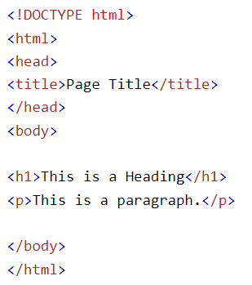
HTML stands for Hyper Text Markup Language
HTML is the standard markup language for creating Web pages
HTML describes the structure of a Web page
HTML consists of a series of elements
HTML elements tell the browser how to display the content
HTML elements label pieces of content such as "this is a heading", "this is a paragraph", "this is a link", etc.

Slide 3
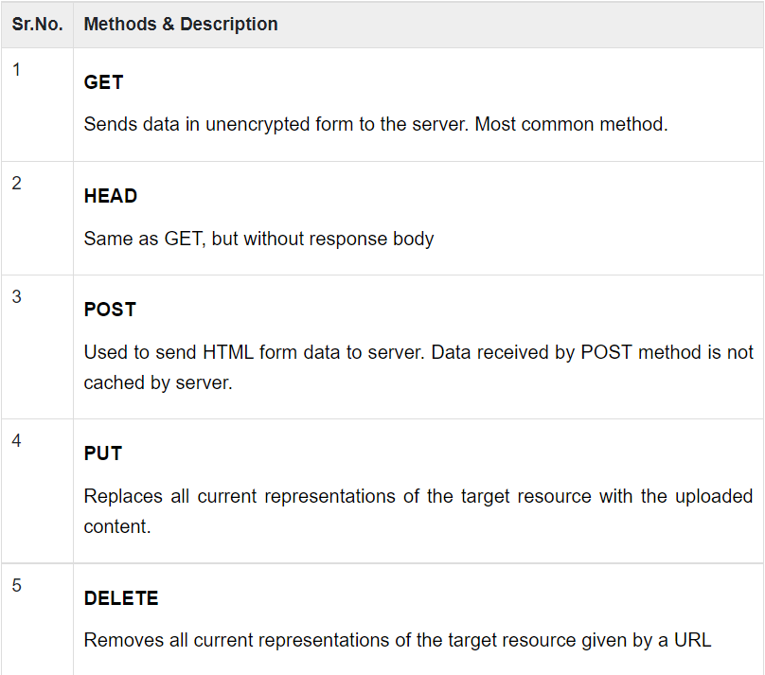

Slide 4
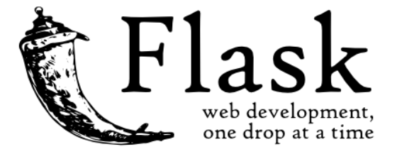
Flask is a web application (micro)framework written in Python. It is developed by Armin Ronacher, who leads an international group of Python enthusiasts named Pocco. Flask is based on the Werkzeug WSGI toolkit and Jinja2 template engine. Both are Pocco projects.
https://www.digitalocean.com/community/tutorials/how-to-make-a-web-application-using-flask-in-python-3

Slide 5
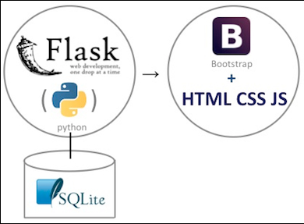

Slide 6
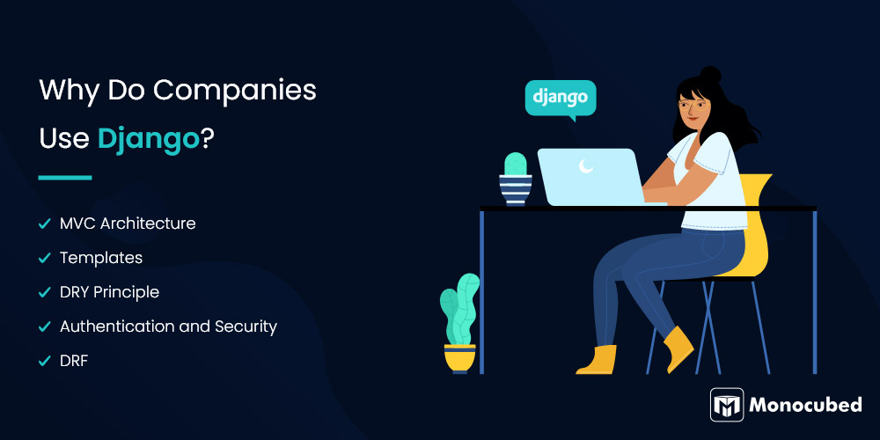

Slide 7
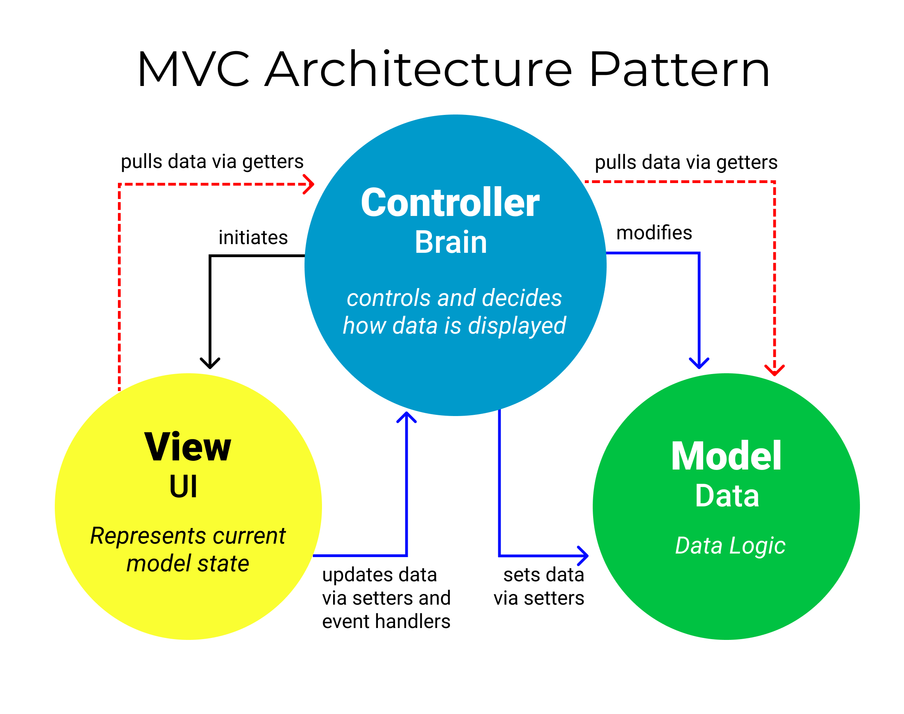
MVC Architecture - The MVC (Model-View-Controller) architecture enables easy distinction between different layers of a web app. You can work with the application’s visual presentation and logic independently, and Django will automatically update and sync the changes.
Templates - Django has a powerful templating engine that works on its personal markup language. Templates are HTML code files that are used to display data- be it static or dynamic. Templates contain no application logic, only having information regarding visual content
DRY Principle “Don’t repeat yourself” - Python employs philosophy to provide developers with a clean, manageable working environment. Django enforces the DRY principle in everything, creating a single space for storing each distinct object.

Slide 8
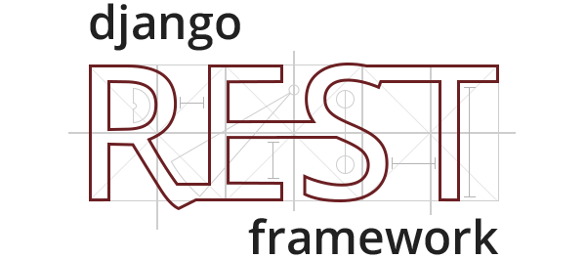
4. Authentication and Security - Developers chose Django because it comes with a full-featured, secure user authentication system. It handles user accounts, manages cookies, user groups, and sessions, and keeps track of permissions. This lets you easily build sites that allow users to create accounts and safely sign in and out of the accounts. Django has a state-of-the-art security system that helps developers against common security lapses such as SQL injection, cross-site scripting, clickjacking, and cross-site request forgery.
5. DRF. The Django REST framework (DRF) is a component toolkit built on top of the Django framework for creating REST APIs. An API is an interface for interacting with databases. RESTful APIs are conformed to the REST architecture and are used for listing, modifying, creating, and deleting data on web servers using the HTTP protocols.

Slide 9
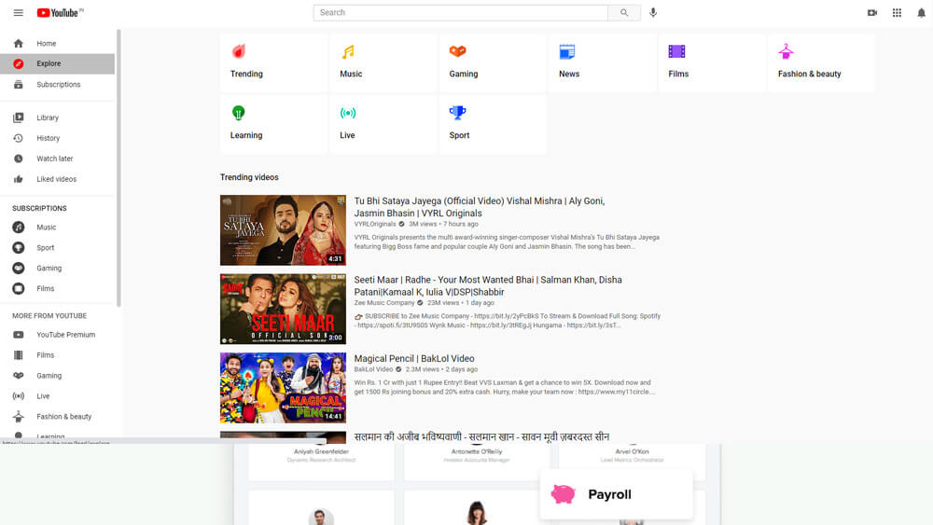
Sites written with Django

Slide 10
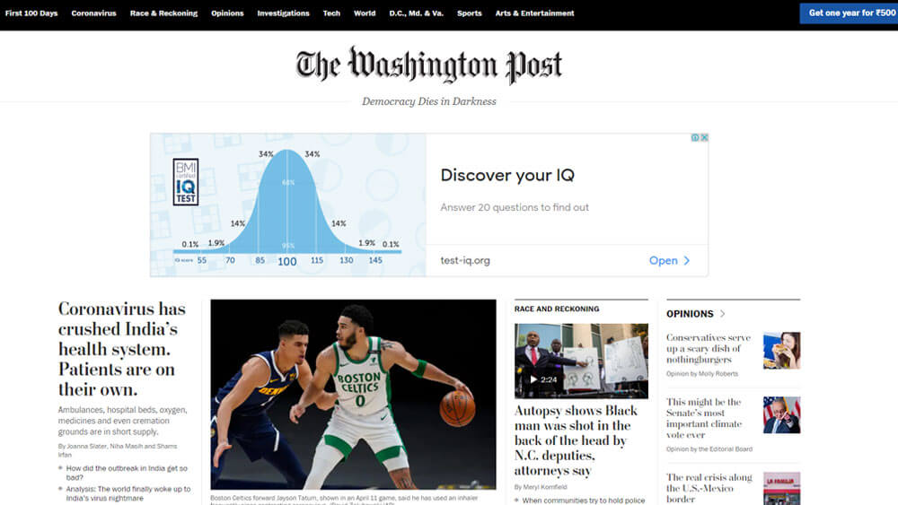
Sites written with Django

Slide 11
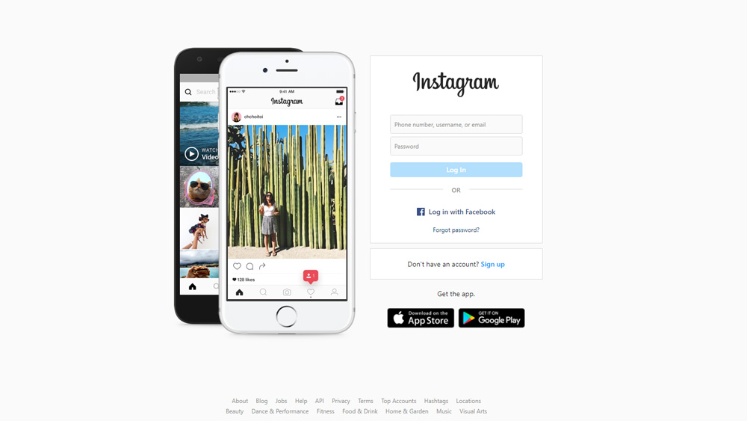
Sites written with Django

Slide 12
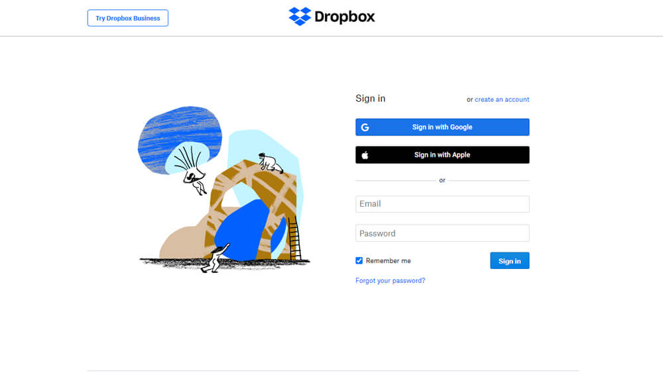
Sites written with Django

Slide 13
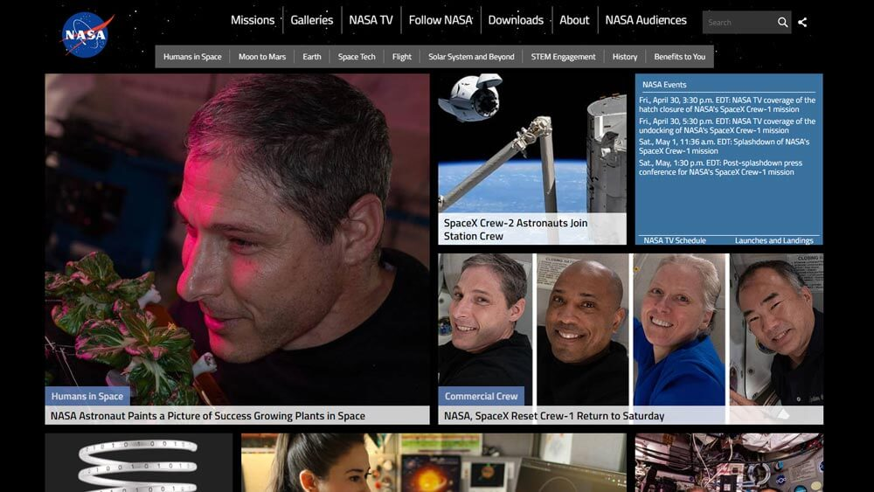
Sites written with Django

Slide 14
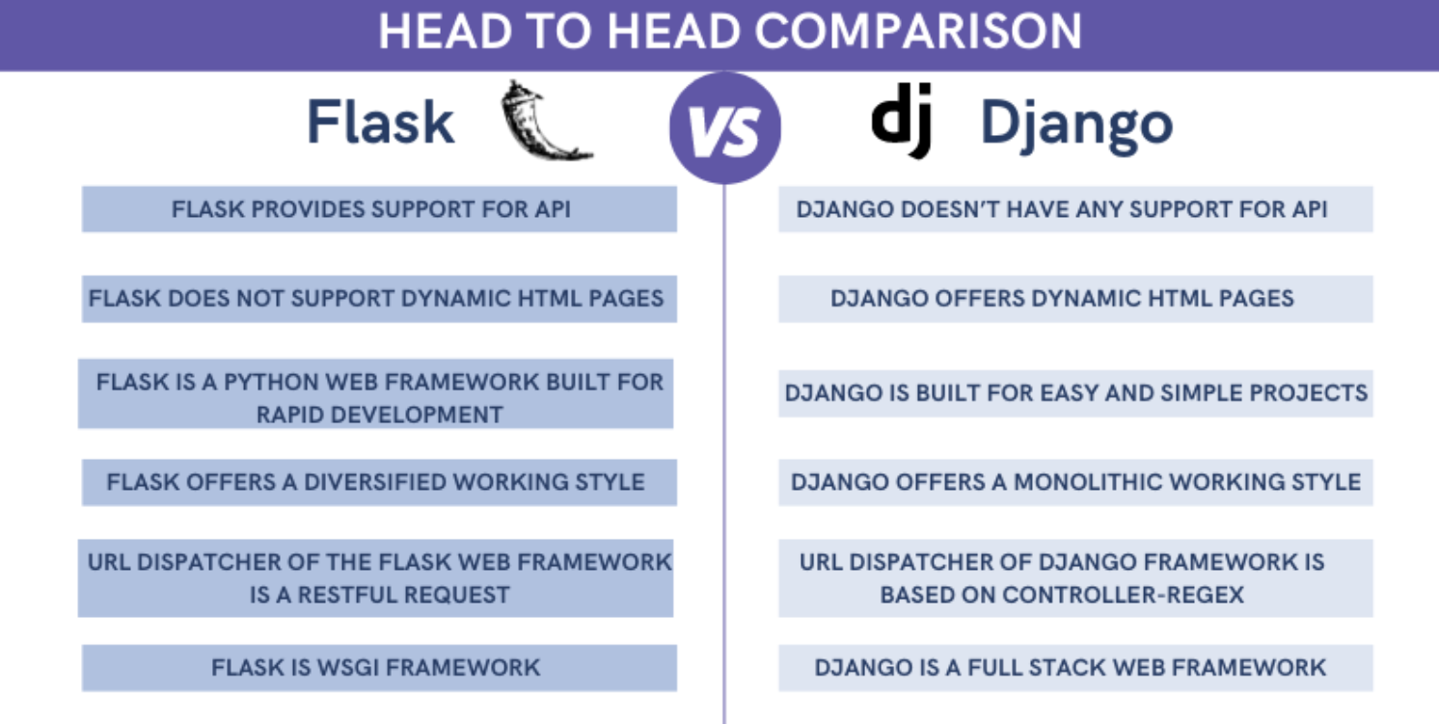

Slide 15
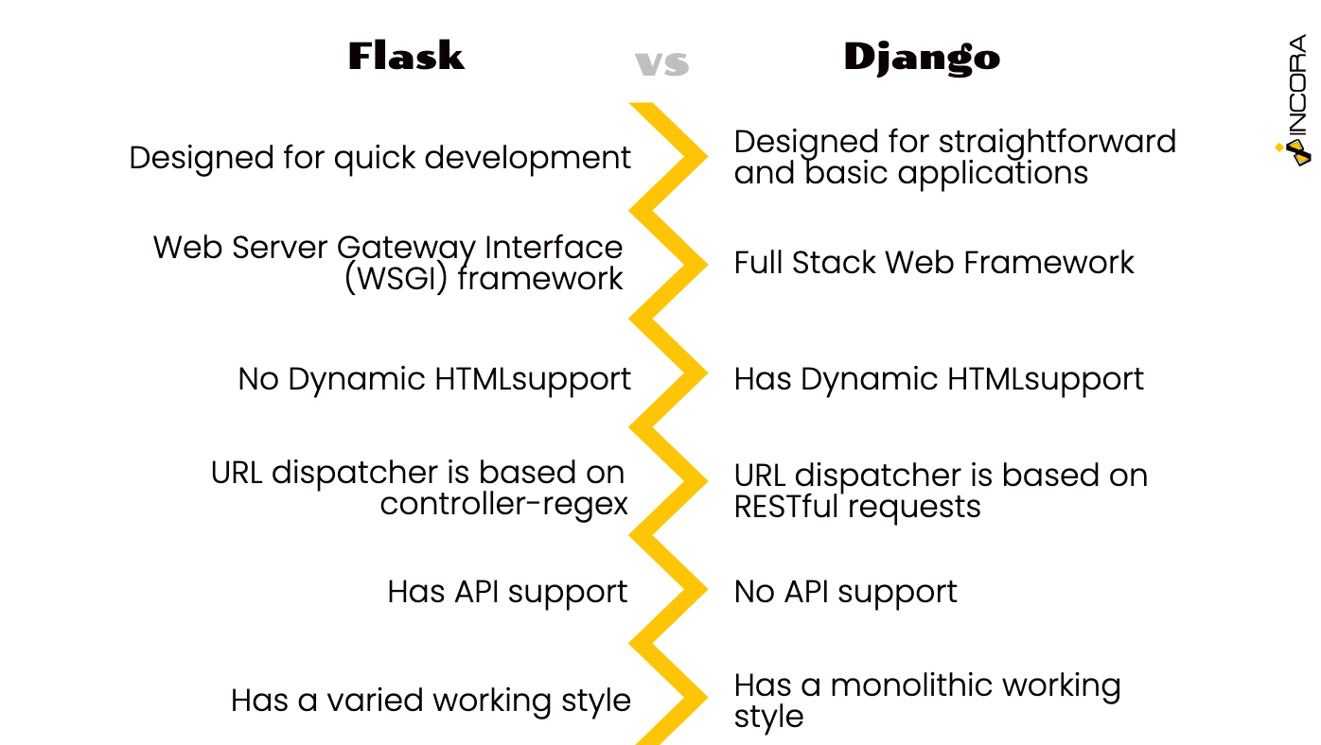

Slide 16
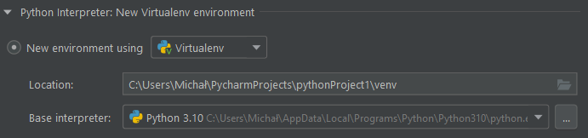

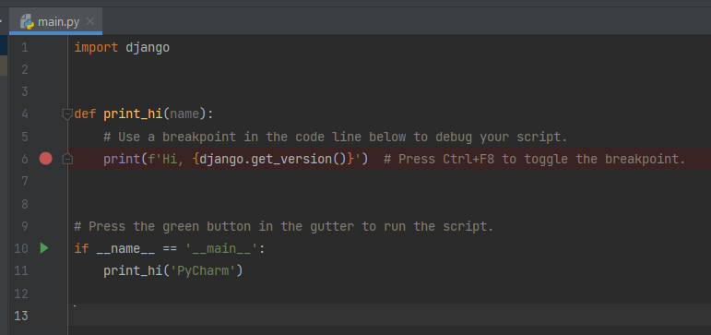
Install django

Slide 17

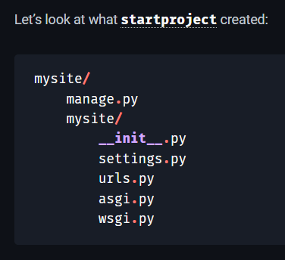
The outer mysite/ root directory is a container for your project. Its name doesn’t matter to Django; you can rename it to anything you like.
manage.py: A command-line utility that lets you interact with this Django project in various ways.
The inner mysite/ directory is the actual Python package for your project. Its name is the Python package name you’ll need to use to import anything inside it (e.g. mysite.urls).
mysite/__init__.py: An empty file that tells Python that this directory should be considered a Python package.
mysite/settings.py: Settings/configuration for this Django project. Django settings will tell you all about how settings work.
mysite/urls.py: The URL declarations for this Django project; a “table of contents” of your Django-powered site.
mysite/asgi.py: An entry-point for ASGI-compatible web servers to serve your project.
mysite/wsgi.py: An entry-point for WSGI-compatible web servers to serve your project.

